Slide 1


Green Pace
Security Policy Presentation
Developer: Kathryn McNeil

Slide 2

OVERVIEW: DEFENSE IN DEPTH
The security policy that will be used for Green Pace is Defense in Depth. This is a technique that makes a system more secure through the use of multiple security layers. By using multiple layers, vulnerabilities in the system can be covered, and the likelihood of a malicious user being able to penetrate the system goes down.

Slide 3
THREATS MATRIX
Likely SQL Injection Memory Protection Memory String Correctness Data Value Containers Exceptions | Priority SQL Injection Memory Protection Memory String Correctness Data Value
Low priority Containers Exceptions Assertions Declarations Data Type | Unlikely Assertions Declarations Data Type
Notes:
Threats matrix
The threats matrix is made up of four different parts: likely, priority, low priority, and unlikely. Likely threats are threats that are likely to occur and can have a range of threat levels. Priority threats are those that must be handled or watched out for the most. These will typically have higher consequences such as higher remediation costs and threat levels. Low priority threats do not have large consequences or threat levels. They are to be handled after the priority threats. Unlikely threats are those that are not likely to happen. As with the likely threats they have a range of threat levels and consequences.
In Likely threats we have identified SQL Injection, memory protection, memory, string correctness, data value, containers, and exceptions. We can see SQL Injection, memory protection, memory, string correctness, and data value are also priority threats. This is because they are likely to occur and have high threat levels. Containers, exceptions, assertions declarations and data type are all low priority threats. Even though containers and exceptions are likely to occur, their low threat level places them as low priority. Assertions, declarations, and data type are low priority because they are unlikely and have low threat levels.

Slide 4
10 PRINCIPLES
1. Validate Input Data
SQL injection
2. Heed Compiler Warnings
Data type
Data value
String correctness
Memory protection
Exceptions
Memory
3. Architect and Design for Security Policies
SQL injection
Assertions
Exceptions
4. Keep It Simple
Memory protection
SQL injection
5. Default Deny
SQL injection
Memory protection
6. Adhere to the Principle of Least Privilege
SQL injection
Memory protection
7. Sanitize Data Sent to Other Systems
SQL injection
8. Practice Defense in Depth
Memory protection
9. Use Effective Quality Assurance Techniques
Data type
Data value
String correctness
SQL injection
Memory protection
Assertions
Exceptions
Memory
Declarations
10. Adopt a Secure Coding Standard
Data type
Data value
String correctness
Memory protection
Memory
Declarations
Containers
Notes:
10 Principles
Here we have the 10 principles listed out along with the coding standards that relate to them. First is validate input data with the coding standard SQL injection. Next is heed compiler warnings, this relates to a lot of coding standards. I have listed Data type, data value, string correctness, memory protection, exceptions, and memory. Architect and design for security policies is number three with SQL injection, assertions, and exceptions. Number four is keep it simple with memory protection and SQL injection. Then we have default deny with SQL injection and memory protection. Number six is adhere to the principle of least privilege also containing SQL injection and memory protection. Number seven is sanitize data sent to other systems, this prevent SQL injection. Number eight is practice defense in depth with memory protection. Number nine is use effective quality assurance techniques, most coding standards can relate to this. I have listed data type, data value, string correctness, SQL injection, memory protection, assertions, exceptions, memory, and declarations. Lastly we have adopt a secure coding standard with data type, data value, string correctness, memory protection, memory, declarations and containers.

Slide 5
CODING STANDARDS
1. STD-004-C SQL injection
Priority, likely
Medium cost
High threat level
2. STD-005-CPP Memory protection
Priority, likely
Medium cost
High threat level
3. STD-008-CPP Memory
Priority, likely
Medium cost
High threat level
4. STD-004-C String correctness
Priority, likely
Medium cost
High threat level
5. STD-002-CPP Data value
Priority, probably
High cost
Moderate threat level
6. STD-010-CPP Containers
Low priority, probable
High cost
Low threat level
7. STD-007-CPP Exceptions
Low priority, probable
Medium cost
Low threat level
8. STD-006-C Assertions
Low priority, unlikely
High cost
Low threat level
9 . STD-009-CPP Declarations
Low priority, unlikely
Medium cost
Low threat level
10. STD-001-CPP Data type
Low priority, unlikely
Medium cost
Low threat level
Notes:
Coding Standards
Here we have our 10 coding standards listed in order from highest priority to lowest.
SQL injection. This is a priority threat that is likely to occur with medium cost and a high threat level. It is likely to occur with a high threat level so this coding standard is a top priority.
Memory protection: This is a priority threat that is likely to occur with medium cost and a high threat level. This coding standard is a priority because memory contains sensitive data. Due to this, memory protection is essential for preventing malicious users from accessing the information.
Memory: this is a priority threat that is likely to occur with medium cost and a high threat level. This coding standard also handles memory, so it is a high priority. Memory is one of the main targets of malicious users so it should be a security focus.
String correctness: this is a priority threat that is likely to occur with medium cost and a high threat level. Like the past three standards this one is also a high priority. Although it is listed below memory it is still very important for strings to be declared correctly to prevent vulnerabilities.
Data value: A priority that will probably occur with high costs and a moderate threat level. This standard is still a priority; however, it is slightly less likely to occur and only a moderate threat. Because of this it is not a top priority, however, one should note that the cost for remedying this coding standard is high. This may make it a higher priority for some people.
Containers: A low priority threat that is probable to occur with high costs and a low threat level. This standard is a low threat; however, it has a high remediation cost. Because of this it is the first of the low-level threats on the list.
Exceptions: A Low priority threat that is probable to occur with medium cost and a low threat level. This standard is only probable to occur, and a low threat. I have listed it above assertions which have high remediation costs because it is more likely to occur.
Assertions: a Low priority threat that is unlikely to occur with high costs and a low threat level. Assertions are the first of three standards which are labeled “unlikely”. Out of the three, assertions have the highest cost, so it is listed first.
Declarations: A Low priority threat that is unlikely to occur with medium cost and a low threat level. Declarations and data type are comparable in terms of priority as they have the same specs and can both create vulnerabilities.
Data type: A Low priority threat that is unlikely to occur with medium cost and a low threat level. Data type is low priority due to it being low threat and unlikely to occur.

Slide 6
CODING STANDARDS
Rule | Severity | Likelihood | Remediation Cost | Priority | Level
STD-001-CPP | Medium | Unlikely | Medium | P4 | L3
STD-002-CPP | High | Probably | High | P6 | L2
STD-003-CPP | High | Likely | Medium | P18 | L1
STD-004-C | High | Likely | Medium | P18 | L1
STD-005-CPP | High | Likely | Medium | P18 | L1
STD-006-C | Low | Unlikely | High | P1 | L3
STD-007-CPP | Low | Probable | Medium | P4 | L3
STD-008-CPP | High | Likely | Medium | P18 | L1
STD-009-CPP | Low | Unlikely | Medium | P2 | L3
STD-010-CPP | Low | Probable | High | P2 | L3
Notes:
Table for each coding standard along with their severity, likelihood, remediation cost, priority, and level.

Slide 7
ENCRYPTION POLICIES
Encryption in rest
Encryption at flight
Encryption in use
Protects data even when not in use (at rest)
Data at rest: data not used daily
Typically protected behind a firewall
Encryption improves security
To encrypt data a transformation occurs
Data is encrypted into a different form
Only authorized users can transform data back to its original form
While encrypted it is unreadable
Data in flight: data transferred over a network.
Very vulnerable
Encryption at flight: Encrypts data in flight
Protects data during transit
Raw data is encrypted
Data is transferred
Upon access data will be unencrypted
Data is secure at every lifecycle stage
Protects data at all times
Limits the opportunities for malicious users to access that data.
Only unencrypted at certain times
Access is controlled
Notes:
Encryption Policies
The three encryption policies are encryption in rest, at flight, and in use.
Encryption in rest refers to protecting data even when it is not being used. Data at rest is that which is not used on a daily basis. Although data is often protected behind a firewall, encryption needs to be used to improve security. To encrypt this data a transformation occurs. The data is taken out of its original form and encrypted into a different form that cannot be understood by outsiders. Only those with authorized access are able to transform the data back into its original form.
Data in flight refers to data that is transferred over a network, it is moving from one place to the next. Data is very vulnerable during this process and so it is vital for it to be properly protected. Encryption at flight refers to encrypting this data in flight so it is protected during transit. During this process raw data is encrypted, transferred, and then unencrypted when it is ready to be accessed.
With encryption in use data is secure at every lifecycle stage. When data becomes unencrypted, access is controlled limiting threats to it. This is very beneficial as it protects data at all times, limiting the opportunities for malicious users to access that data.

Slide 8
TRIPLE-A POLICIES
Authentication
Authorization
Accounting
Process of properly identifying users
Prevents malicious users from accessing system
Good authentication:
Users enter unique identifying information (user login)
Protects user credentials so malicious users cannot access internal credentials and take advantage of them.
Determines:
who can issue certain commands
who can make changes to the database
who can add new users
level of access a user can reach
A must for companies
prevents malicious users from issuing commands they should not be able to.
Tracks what resources are used by a user while accessing the system
Should track:
how much data is being set in a session
where it is being sent to
how long the user has had a session for
how often they do certain things
Notes:
Triple-A Policy
The Triple-A Policy is authentication, authorization, and accounting.
Authentication is properly identifying users while preventing malicious ones from posing as someone they are not. Good authentication requires uses to enter unique information that identifies them, this is user login. This information also needs to be protected in order to prevent malicious users from pulling out internal credentials and taking advantage of them.
Authorization refers to who can issue certain commands. Companies need to have secure authorization processes in place to prevent malicious users from issuing commands they should not be able to. Authorization handles who can make changes to the database, who can add new users, and the level of access a user can reach. This is very important as you do not want a malicious user to create a new user, give it a high level of access, and then make changes to the database.
Accounting means tracking what resources are used by a user while accessing the system. Accounting should track how much data is being sent in a session, where it is being sent to, how long the user has had a session for, and how often they do certain things. Keeping track of this data will make it a lot easier to find a data breach as you can easily track which files were accessed by users as well as other processes.

Slide 9
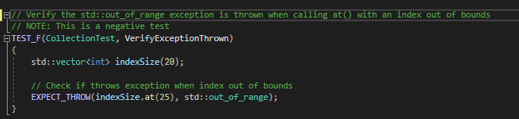
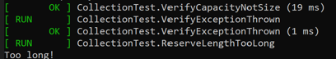
Unit Test 1: Is the value out of range?
Data type: Casting to out of range value
- Assert that an out-of-range value cannot be cast to
Notes:
Unit test 1: Is the value out of range?
The test covers the coding standard data type. It checks if an out of range value is cast to by throwing an exception. We can see that an exception is thrown when the value is out of range so our test passed.

Slide 10
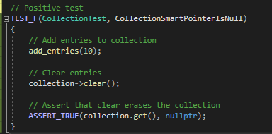
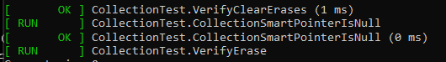
Unit Test 2: Has the allocated resource been properly deallocated?
Memory protection: Making sure the smart pointer is null after deallocating the memory
- Assert that the collection has a null pointer
Notes:
Unit test 2: Has the allocated resource been properly deallocated?
The test covers the coding standard memory protection. It makes sure the smart pointer is null after deallocating the memory by asserting that the collection has a null pointer. The test passes so it was true that the collection contains a null pointer.

Slide 11
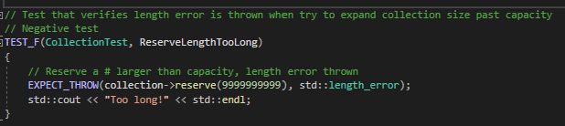
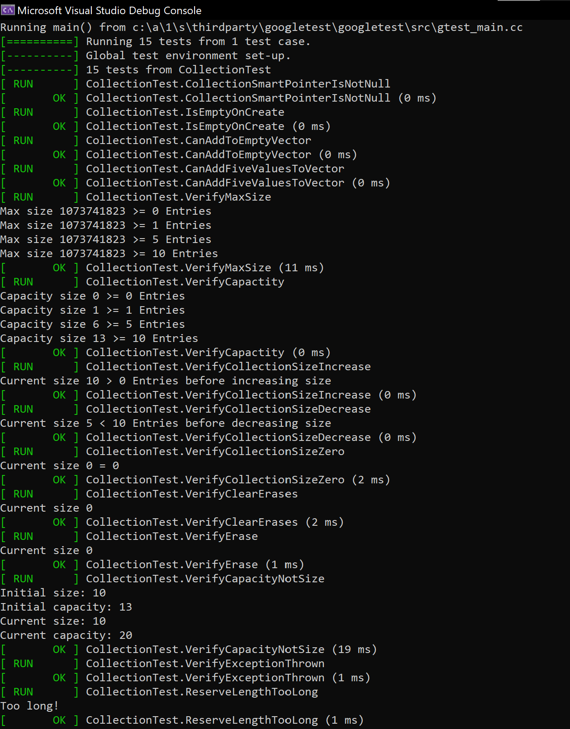
Unit Test 3: Is an exception thrown?
Exceptions: Verifies an exception is thrown when expected
- Throws exception when trying to reserve space in the collection goes over capacity
Notes:
Unit test 3: Is an exception thrown?
The test covers the exceptions coding standard. It verifies an exception is thrown when expected. It throws an exception when trying to reserve space in the collection goes over capacity. The test passes so the exception is indeed thrown.

Slide 12
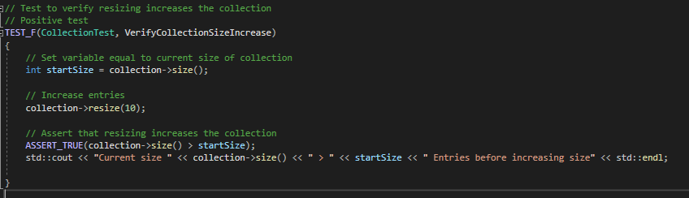
Unit Test 4: Is a valid data value used?
Data value: Verifies that “collection” can be referenced to compare it to the valid data value “startSize”
- Asserts that collection size is greater than the start size, it comes back true showing all values are valid as we get the expected result
Notes:
Unit Test 4: Is a valid data value used?
This test covers the coding standard data value. It verifies that “collection” can be referenced in order to compare to the data value “startSize”. It asserts that collection size is greater than the start size, so all data values are valid and our test passes.

Slide 13

AUTOMATION SUMMARY
Notes:
Automation Summary:
Here is a visual of the devsecops lifecycle, on one side we have pre-production and on the other we have post-production. Starting at the top of pre-production we have “asses and plan”- threat landscape, regulatory changes, change impact analysis; prioritize backlog, respond to new threats. Next is “design”- (security) test-driven design, app best practices (OWASP, etc.). After that is “build”- secure build, trusted repositories, secure open-source usage. The last part of pre-production is “verify and test”- vulnerability scanning, trusted source (digitally signed); functional, compliancy and security testing. We then move to the top of production, “transition and health check”- configure and deploy, security settings, penetration test. Next is “monitor and detect”- log collection, SIEM, analytics, event alerting, intrusion detection. After that we have “respond”- block attacks, turn off services, roll back. The last part of production is “maintain and stabilize”- assess against security baseline, return to baseline, return to stable state after attack/compromise.

Slide 14
TOOLS
DevSecOps: development, security, and operations
Pre-production & Production
Two cycles that are constantly swapped between throughout a systems lifetime
The pipeline starts with pre-production’s “assess and plan”
Flows through the pre-production cycle until the system is ready for production
In production starts with “transition and health check”
Flows through this cycle until the system needs to be revamped
At this point can either start at the beginning with “assess and plan” or simply continue through the production lifecycle to watch for security threats and address them
Diagrams
Websites such as Lucid Chart provide tools for creating diagrams in the assess and plan/ design phase
OWASP
Can be used during design to improve the systems security from the start
Can also be used during the verify and test phase to identify vulnerabilities and propose solutions
IDE
An IDE that you trust can be used to build the program
Tools can be downloaded to check for errors and vulnerabilities
Unit tests
The verify and test phase will utilize these to ensure the program gives the desired results
CPPChecker
Can also be used during the verify and test phase
Finds vulnerabilities and other issues with your code
Notes:
Tools:
The security strategy we will use is DevSecOps: development, security, and operations. It is made up of two parts: pre-production and production. The two cycles that are constantly swapped between throughout a systems lifetime. The pipeline starts with pre-production’s “assess and plan”. It then flows through the pre-production cycle until the system is ready for production. Production starts with “transition and health check”, the production cycle is then flown through until the system needs to be revamped. At this point you can either start at the beginning with “assess and plan” or simply continue through the production lifecycle to watch for security threats and address them.
For this technique diagrams are a great tool for development. Websites such as Lucid Chart provide tools for creating diagrams in the assess and plan/ design phase. OWASP can also be used during design to improve the systems security from the start. It can also be used during the verify and test phase to identify vulnerabilities and propose solutions. It is important to have a good IDE. An IDE that you trust can be used to build the program. Tools can be downloaded to check for errors and vulnerabilities. CPPChecker is a great example of this and can be used during the verify and test phase to find vulnerabilities and other issues with your code. During the verify and test phase unit tests can also be utilized to ensure the program gives the desired results

Slide 15
RISKS AND BENEFITS
Act Now
Reduce the cost of vulnerability detection through automation
Flexible solution that accepts changes
Faster development
Imporoves quality control
Improved collaboration between teams
Wait
Faster development implies overlooked vulnerabilities
Design vulnerabilities more difficult to find
Lack of documentation early on
Adopting DevSecOps will help speed up the development process through the use of automation
This will save the company money, free up time for people to work on other things, and limit human error
Automation can miss vulnerabilities, or provide false positives
Lack of documentation could pose a problem for certain companies who need extensive documentation
Demands good communication to work properly
Notes:
Risks and Benefits:
Like anything in life. devsecops has both pros and cons. The pros of it is it reduces the cost of vulnerability detection through the use of automation. It also provides flexible solutions that accept changes, and faster development. People also see that it improves quality control as well as collaboration between teams. Some cons are that it has faster development time, this implies overlooked vulnerabilities. It also creates more difficult to find design vulnerabilities and lacks early documentation.
So, adopting DevSecOps will help speed up the development process through the use of automation. This will save the company money, free up time for people to work on other things, and limit human error. On the flip side, automation can miss vulnerabilities, or provide false positives leading to security vulnerabilities. Lack of documentation could also pose a problem for certain companies who need extensive documentation. Because it demands good communication to work properly this will not work for every company.

Slide 16
RECOMMENDATIONS
As pointed out on the prior screen vulnerabilities can easily be overlooked
How can these vulnerabilities be detected?
Can have a human look over the results before moving on
Improve communication between teams to ensure nothing is overlooked
Heed any software flaws that are detected so they can be fixed early on
This will also help prevent other problems from occurring due to it
Pay special attention to places where vulnerabilities are easily overlooked
Good quality assurance techniques will help with this
Adopt a secure coding standard
This will help avoid many small preventable problems
Faster development means more time for testing- take advantage of this!
Notes:
Recommendations:
As pointed out on the prior screen vulnerabilities can easily be overlooked. It is important to work around this problem through utilizing techniques that help detect vulnerabilities. So, how will these vulnerabilities be detected? You can have a human look over the results of the test before moving on. This ensures that all the results are accurate and do not include false positives or negatives that will affect security. You can also improve communication between teams to ensure nothing is overlooked. Devsecops is a great strategy, however, it demands proper communication. If proper communication cannot be achieved then the strategy may do more harm than good. You should also heed any software flaws that are detected so that they can be fixed early on. It is important to fix all issues as soon as possible as this will also help prevent the problem from snowballing and causing other issues. You want to pay special attention to places where vulnerabilities are easily overlooked. You should familiarize yourself with your tools and language enough that it is easy to determine where vulnerabilities may occur. Good quality assurance techniques will help with this, as will adopting a secure coding standard. This will help avoid many small preventable problems. Lastly, faster development means more time for testing- take advantage of this!

Slide 17
CONCLUSIONS
Developers should follow the core security principles
Validate input data
Heed compiler warnings
Architect and design for security policies
Keep it simple
Default deny
Adhere to the principle of least privilege
Sanitize data sent to other systems
Practice defense in depth
Use effective quality assurance techniques
Adopt a secure coding standard
Should also know and understand the coding standard rules for whatever language they are working in
Should utilize tools such as CPPChecker, and OWASP to find and address vulnerabilities
Should always put security first
Notes:
Conclusion:
Developers should follow the core security principles:
Validate input data
Heed compiler warnings
Architect and design for security policies
Keep it simple
Default deny
Adhere to the principle of least privilege
Sanitize data sent to other systems
Practice defense in depth
Use effective quality assurance techniques
Adopt a secure coding standard
They should also know and understand the coding standard rules for whatever language they are working in. It is also important to utilize tools such as CPPChecker, and OWASP to find and address vulnerabilities therefore improving security. Lastly, they should always put security first.

Slide 18
REFERENCES
Brightline IT. (2017, May 17). What is encryption at rest, and why is it important for your business? https://brightlineit.com/encryption-at-rest-important-business/
Carnegie Mellon University. (2020, May 29). SEI CERT C++ coding standard. https://wiki.sei.cmu.edu/confluence/pages/viewpage.action?pageId=88046682
Carter, E. (2021, July 7). The role of automation in software development lifecycle. Kaholo. https://kaholo.io/blog/the-role-of-automation-in-software-development-lifecycle/
Cppreference.com (n.d.) C++ reference. https://en.cppreference.com/w/
Cplusplus.com. (n.d.). Reference: Standard C++ library reference. https://cplusplus.com/reference/.
Das, P. (n.d.). In-use encruption- What it is and how companies benefit. Sotero. https://www.soterosoft.com/blog/data-in-use-encryption-data-in-motion-encryption/#:~:text=In%2DUse%20encryption%20takes%20a,%2C%20cloud%2C%20or%20hybrid).
Faso, V. L. (2015, April 28). How to protect data in flight. Skillsoft Global Knowledge. https://www.globalknowledge.com/us-en/resources/resource-library/articles/how-to-protect-data-in-flight/
GeeksforGeeks. (2022, February 28). Assertions in C/C++. https://www.geeksforgeeks.org/assertions-cc/#:~:text=Assertions%20are%20statements%20used%20to,void%20assert(%20int%20expression%20)%3B
Get Secure World. (n.d.) Pros and cons of devsecops. https://www.getsecureworld.com/blog/pros-and-cons-of-devsecops/
Jacob Sorber. (2017, August 2). Find bugs faster using assertions [video]. Youtube. https://www.youtube.com/watch?v=1Jh9BUxIw0U.
Robert Seacord. (2022, April 27). STR02-C. Sanitize data passed to complex subsystems. Carnegie Mellon University Software Engineering Institute. https://wiki.sei.cmu.edu/confluence/display/c/STR02-C.+Sanitize+data+passed+to+complex+subsystems
Seacord, R. (2013). Secure Coding in C and C++. Addison-Wesley.
Seacord, R. (2011, March 1). Top 10 secure coding practices. Secure Coding. http://web.archive.org/web/20160404152049/https://www.securecoding.cert.org/confluence/display/seccode/Top+10+Secure+Coding+Practices.
TechTarget Contributor. (n.d.). Authentication, authorization, and accounting (AAA). TechTarget. https://www.techtarget.com/searchsecurity/definition/authentication-authorization-and-accounting#:~:text=Authentication%2C%20authorization%2C%20and%20accounting%20(AAA)%20is%20a%20term,necessary%20to%20bill%20for%20services.

